Slide 1

Updating in treatment
chronic graft versus host disease (cGvHD)
M. Shaheen
MD.Hematologist
Tishreen Hospital
08/12/2022

Slide 2

Allogeneic Hematopoietic Cell Transplantation
Involves the use of hematopoietic cells from another person
Allows for GVL effect
Mobilized graft
HSCs
T-cells
NK cells
DCs
B cells
Mobilization
Conditioning
Marrow suppressive
Lymphodepleting
Tumor cytoreduction
GVHD prophylaxis
Copelan. Blood Rev. 2019;34:34.
Notes:
DC, dendritic cells; GVHD, graft-vs-host disease; GVL, graft vs leukemia; HSC, hematopoietic stem cells; NK cells, natural killer cells.

Slide 3
What Is GVHD?
Donor immune cells mounting an attack against the recipient
Acute GVHD occurs in 30%
to 60% of patients receiving allogeneic hematopoietic cell transplantation, depending
on donor, graft source, conditioning regimen, GVHD prophylaxis regimen, and other factors^{[1]}
Correlation between GVHD and GVL^{[2]}:
1.0
0.8
Twins (N = 70)
0.6
Posttransplant
Probability of Relapse
T Depletion (N = 401)
0.4
No GVHD (N = 433)
aGVHD only (N = 738)
0.2
cGVHD only (N = 127)
0
aGVHD + cGVHD (N = 485)
0
12
24
36
48
60
72
Mos
1. Zeiser. NEJM. 2017;377:2167. 2. Horowitz. Blood. 1990;75:555.
Notes:
a, acute; c, chronic; GVHD, graft-vs-host disease; GVL, graft vs leukemia.

Slide 4
Acute and Chronic GVHD
LATE ACUTE
CLASSIC
ACUTE
OVERLAP
CLASSIC
CHRONIC
Day 0 Day 100
Lee. Blood. 2017;129:30.
Notes:
GVHD, graft-vs-host disease

Slide 5
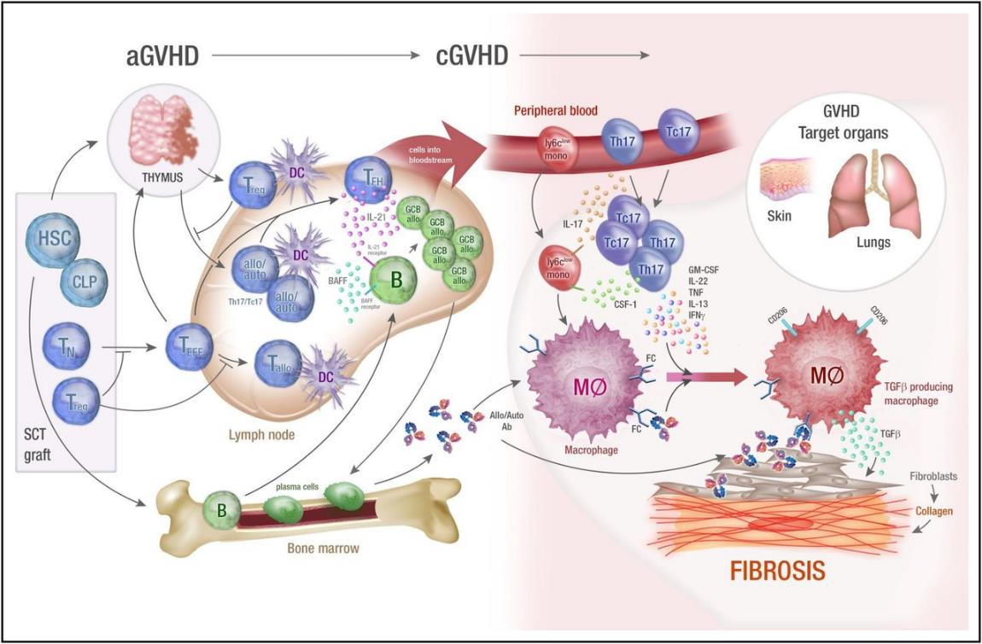
Pathophysiology of Chronic GVHD
Alloreactive immune cells secrete proinflammatory cytokines, driving fibrosis
Republished with permission of American Society of Hematology from Chronic graft-versus-host disease: biological insights from preclinical and clinical studies, MacDonald KPA. Blood. 2017;129(1):13; permission conveyed through Copyright Clearance Center, Inc.
Notes:
Ab, antibody; BAFF, B-cell activating factor; CLP, common lymphoid progenitor; CSF-1, colony-stimulating factor 1; DC, dendritic cell; GCB, germinal center B-cells; GM-CSF, granulocyte-macrophage colony-stimulating factor; GVHD, graft-vs-host disease; HSC, hematopoietic stem cell; IFNγ, interferon gamma; IL, interleukin; TFH, T-follicular helper cell; TGFβ, transforming growth factor beta; TN, naïve T-cells; TNF, tumor necrosis factor.

Slide 6
Pathophysiology of Chronic GVHD
Phase I: T-cell alloreactivity and innate immunity
Donor graft provides HSCs and
T-cells
  Alloreactive T-cells cause acute GVHD driven by conditioning and infection inflammation
  Alloreactive T-cells damage thymus, bone marrow, and follicular germinal centers, leading to cGVHD
Republished with permission of American Society of Hematology from Chronic graft-versus-host disease: biological insights from preclinical and clinical studies, MacDonald KPA. Blood. 2017;129(1):13; permission conveyed through Copyright Clearance Center, Inc.
Notes:
Ab, antibody; BAFF, B-cell activating factor; CLP, common lymphoid progenitor; CSF-1, colony-stimulating factor 1; DC, dendritic cell; GCB, germinal center B-cells; GM-CSF, granulocyte-macrophage colony-stimulating factor; GVHD, graft-vs-host disease; HSC, hematopoietic stem cell; IFNγ, interferon gamma; IL, interleukin; TFH, T-follicular helper cell; TGFβ, transforming growth factor beta; TN, naïve T-cells; TNF, tumor necrosis factor.

Slide 7
Pathophysiology of Chronic GVHD
Phase II: Dysregulated immunity drives chronic inflammation
de novo immune cells arise from HSCs dependent on damaged thymus and bone marrow
  Dysregulation of T follicular helper cells and B-cells leads to overproduction of allogeneic antibodies and
  T-cells polarized to TH17 phenotype
Republished with permission of American Society of Hematology from Chronic graft-versus-host disease: biological insights from preclinical and clinical studies, MacDonald KPA. Blood. 2017;129(1):13; permission conveyed through Copyright Clearance Center, Inc.
Notes:
Ab, antibody; BAFF, B-cell activating factor; CLP, common lymphoid progenitor; CSF-1, colony-stimulating factor 1; DC, dendritic cell; GCB, germinal center B-cells; GM-CSF, granulocyte-macrophage colony-stimulating factor; GVHD, graft-vs-host disease; HSC, hematopoietic stem cell; IFNγ, interferon gamma; IL, interleukin; TFH, T-follicular helper cell; TGFβ, transforming growth factor beta; TN, naïve T-cells; TNF, tumor necrosis factor.

Slide 8
Pathophysiology of Chronic GVHD
Phase III - Fibrosis and Aberrant Tissue Repair
3. Overproduction of proinflammatory cytokines IL-17, IL-21, IFN-γ, and alloAB drives macrophage inflammation
and fibrosis
Republished with permission of American Society of Hematology from Chronic graft-versus-host disease: biological insights from preclinical and clinical studies, MacDonald KPA. Blood. 2017;129(1):13; permission conveyed through Copyright Clearance Center, Inc.
Notes:
Ab, antibody; BAFF, B-cell activating factor; CLP, common lymphoid progenitor; CSF-1, colony-stimulating factor 1; DC, dendritic cell; GCB, germinal center B-cells; GM-CSF, granulocyte-macrophage colony-stimulating factor; GVHD, graft-vs-host disease; HSC, hematopoietic stem cell; IFNγ, interferon gamma; IL, interleukin; TFH, T-follicular helper cell; TGFβ, transforming growth factor beta; TN, naïve T-cells; TNF, tumor necrosis factor.

Slide 9
Treatment goals in GVHD
  Improvement or stabilization of organ manifestations
  Limitation of long-term treatment-related toxicities
  Improvement in functional capacity or quality of life
  Improvement in OS
Martin. Blood. 1990;76:1464.
Notes:
CR, complete response; GVHD, graft-vs-host disease; MR, mixed response; NC, no change; P, progression; PR, partial response.

Slide 10
Second-line cGVHD Treatment Options: Rituximab
Rationale: B-cell role in the pathogenesis of cGVHD → allo-antibody, BAFF
  Murine studies demonstrate a role for B-cells in pathogenesis
Hypothesis: B-cell depletion may be effective cGVHD therapy
Patients with extensive steroid-refractory cGVHD (N = 21) received rituximab 375 mg/m²/wk for
4 wk¹
1 additional cycle permitted for patients with no response or an incomplete response 8 wk after first cycle
Significant changes: skin involvement (sclerodermatous and lichenoid), oral pharyngeal score, ocular Schirmer’s test, and rheumatologic symptoms
Clinical Parameter | Study Entry | 1 Yr | P Value
ORR, % | NA | 70
CR rate, % | NA | 10
Median prednisone dose, mg/day Discontinued prednisone, % Prednisone dose reduction of ≥50%, % No change or higher dose, % | 40 NA NA NA | 10 21 68 32 | <.001
Zhang. Blood. 2006;101:2993. Srinivasan. Blood. 2012;119:1570. Cutler. Blood. 2006;108:756.
Notes:
BAFF, B-cell activating factor; cGVHD, chronic graft-vs-host disease; CR, complete response; ORR, overall response rate.

Slide 11
Second-line Chronic GVHD Treatment Options:
Low-Dose IL-2
Rationale: Impairment of Treg function is associated with chronic GVHD
IL-2 is critical for normal Treg development, expansion, activity, and survival
Patients with extensive
steroid-refractory chronic GVHD*
(N = 35)
Daily IL-2 1 x 10⁶ IU/m²
given SC for 12 wks followed by a mandatory 4-wk hiatus
*Active chronic GVHD despite ≥ 4 wks of immunosuppressants with ≥ 0.25 mg/kg/day prednisone prior 12 mos.
Response, %
ORR | 61
CR | 0
PR | 61
SD | 30
PD | 9
Response by Site | n/N (%)
Liver | 6/13 (46)
Skin | 9/27 (33)
GI | 3/10 (30)
Lung | 3/15 (20)
Joint/fascia | 4/23 (17)
1. Koreth. Blood. 2016;128:130. 2. Koreth. NEJM. 2011;365:2055.
Notes:
GI, gastrointestinal; GVHD, graft-vs-host disease; IL, interleukin; PD, progressive disease; SD, stable disease.

Slide 12
Phase IB/II Trial of Ibrutinib in cGVHD After Failure of Corticosteroids
Open-label, multicenter phase IB/II trial
  Recommended phase II dose identified was identified in phase I of the study
Primary endpoint: cGVHD response per NIH 2005 response criteria
Secondary endpoints: rate of sustained response, change in Lee cGVHD symptom scale, change in corticosteroid dose, safety
Exploratory endpoints: effect on lymphoid and myeloid signaling pathways and plasma cytokines and chemokines
Patients with steroid-dependent/refractory cGVHD (>25% BSA “erythematous rash” or
>4 total mouth score),
≤3 prior treatments for cGVHD
(N = 42)
Ibrutinib
420 mg
Until cGVHD progression or unacceptable toxicity
Miklos. Blood. 2017;130:2243. Waller. Biol Blood Marrow Transplant. 2019;25:2002.
Notes:
BSA, body surface area; cGVHD, chronic graft-vs-host disease; NIH, National Institutes of Health; PD, progressive disease; SD, stable disease.

Slide 13
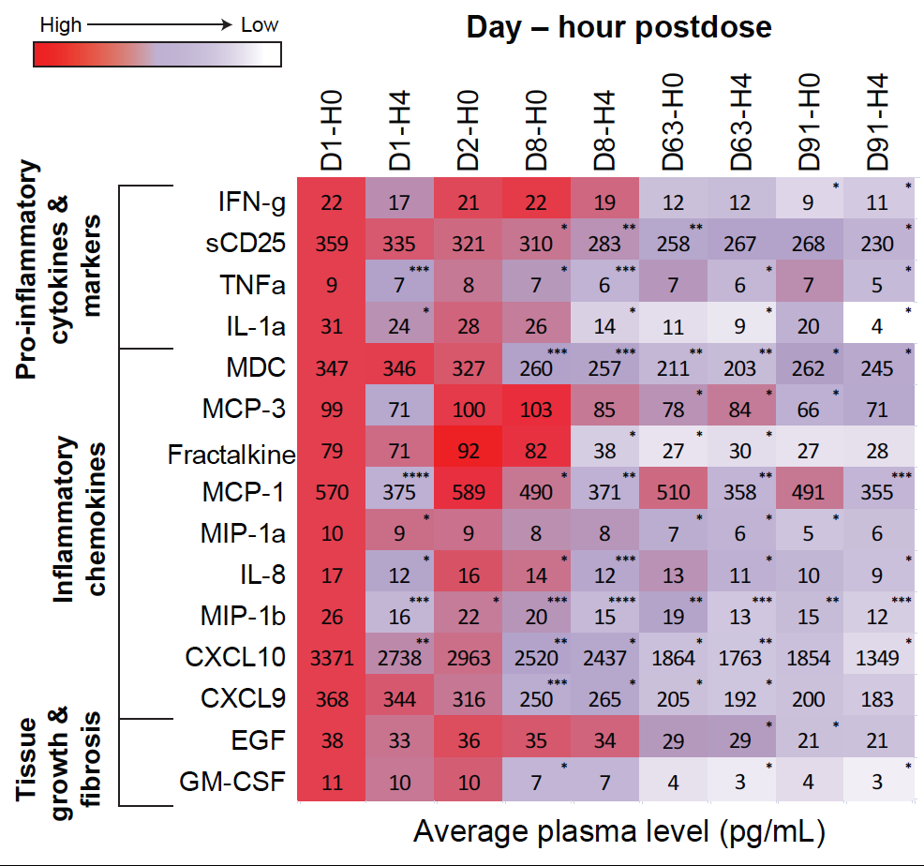
Heatmap of Change in Biomarker Levels
From Baseline by Time After Ibrutinib Dose
Biomarker analysis (n = 42) showed significant reductions in soluble plasma factors that are markers of inflammation and lymphocyte activation, chemotactic factors, and factors or associated with tissue fibrosis
The reductions occurred after ibrutinib administration with an overall downward trend maintained for measured time points
*P <.05, **P <.01, ***P <. 001, ****P <.0001
The values at each time point are expressed as a proportion of the baseline value.
Miklos. Blood. 2017;130:2243.

Slide 14
Conclusions: Ibrutinib for cGVHD
Ibrutinib resulted in clinically meaningful and sustained responses in patients who have failed ≥1 prior treatment for cGVHD
  ORR: 67%
  71% had a sustained response of ≥20 wk
  Similar response rate across all affected organs
Patients experienced reductions in corticosteroid doses while receiving ibrutinib
Biomarker changes support a beneficial effect of ibrutinib on cGVHD-related immune cell subsets
AEs are consistent with those previously reported for ibrutinib and those observed in patients with cGVHD receiving concomitant corticosteroids
Efficacy of ibrutinib in this population supported FDA approval of ibrutinib for patients with established cGVHD requiring additional therapy in August 2017( age ≥12 years).
Miklos. Blood. 2017;130:2243. Ibrutinib PI.
Notes:
AE, adverse event, cGVHD, chronic graft-vs-host disease; ORR, overall response rate.

Slide 15
FDA approves ibrutinib for pediatric patients with chronic graft versus host disease, including a new oral suspension
On August 24, 2022, the Food and Drug Administration approved ibrutinib for pediatric patients ≥ 1 year of age with (cGVHD) after failure of 1 or more lines of systemic therapy. Formulations include capsules, tablets, and oral suspension (70 mg/mL)
Efficacy was evaluated in iMAGINE (NCT03790332), an open-label, multi-center, single-arm trial of ibrutinib for pediatric and young adult patients 1 year to less than 22 years old with moderate or severe cGVHD.
47 patients who required additional therapy after failure of 1 or more lines of systemic therapy.

Slide 16
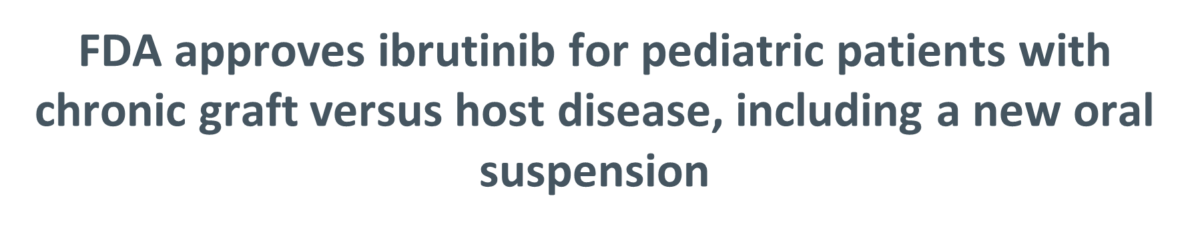
The median age of patients was 13 years (range, 1 to 19).
ORR by Week 25 was 60% (95% CI: 44, 74).
The median duration of response was 5.3 months (95% CI: 2.8, 8.8).
The most common (≥20%) AEs, including laboratory abnormalities, were anemia, musculoskeletal pain, pyrexia, diarrhea, pneumonia, abdominal pain, stomatitis, thrombocytopenia, and headache
The dose in patients ≥12 is 420 mg orally once daily, and for 1 to less than 12 years is 240 mg/m2 orally once daily (up to a dose of 420 mg).

Slide 17
REACH3: Safety up to Wk 24
Outcome at Wk 24 | RUX (n = 165) | BAT (n = 158)
Median duration of exposure,* wk (range) | 41.3 (0.7-127.3) | 24.1 (0.6-108.4)
Any-grade AEs, n (%) | 161 (97.6) | 145 (91.8)
Grade ≥3 AEs, n (%) | 94 (57.0) | 91 (57.6)
Serious AEs, n (%) | 55 (33.3) | 58 (36.7)
AEs led to dose modification, n (%) | 62 (37.6) | 26 (16.5)
AEs led to discontinuation, n (%) | 27 (16.4) | 11 (7.0)
Deaths,† n (%) | 31 (18.8) | 27 (16.5)
*Any systemic cGVHD therapy in main study period. †Most commonly due to cGVHD (RUX, n = 22; BAT, n = 13) and infections (RUX, n = 2; BAT, n = 6).
Zeiser. NEJM. 2021;385:228. Zeiser. ASH 2020. Abstr 77.
Notes:
AE, adverse event; BAT, best available therapy; cGVHD, chronic graft-vs-host disease; RUX, ruxolitinib.

Slide 18
REACH3: AEs Occurring in ≥10% of Patients up to Wk 24
Event, n (%) |  | RUX (n = 165) |  | BAT (n = 158)
 |  | Any Grade | Grade ≥3 | Any Grade | Grade ≥3
Hematologic | Anemia Thrombocytopenia Neutropenia | 48 (29.1) 35 (21.2) 18 (10.9) | 21 (12.7) 25 (15.2) 14 (8.5) | 20 (12.7) 23 (14.6) 8 (5.1) | 12 (7.6) 16 (10.1) 6 (3.8)
Gastrointestinal | Diarrhea Nausea | 17 (10.3) 15 (9.1) | 1 (0.6) 0 | 21 (13.3) 16 (10.1) | 2 (1.3) 2 (1.3)
Infections | Pneumonia | 18 (10.9) | 14 (8.5) | 20 (12.7) | 15 (9.5)
Laboratory abnormalities | ALT increased Cr increased Hypokalemia | 25 (15.2) 23 (13.9) 13 (7.9) | 7 (4.2) 0 3 (1.8) | 7 (4.4) 7 (4.4) 16 (10.1) | 0 1 (0.6) 7 (4.4)
Other | Hypertension Pyrexia Cough Fatigue | 26 (15.8) 26 (15.8) 17 (10.3) 17 (10.3) | 8 (4.8) 3 (1.8) 0 1 (0.6) | 20 (12.7) 15 (9.5) 11 (7.0) 12 (7.6) | 11 (7.0) 2 (1.3) 0 3 (1.9)
Zeiser. NEJM. 2021;385:228. Zeiser. ASH 2020. Abstr 77.
Notes:
AE, adverse event; ALT, alanine aminotransferase; BAT, best available therapy; Cr, creatinine; RUX, ruxolitinib.

Slide 19
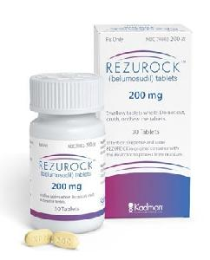
ROCK Is an Intracellular Integrator of Profibrotic Signals
Rho-associated coil-coil kinase (ROCK) is a serine/threonine kinase¹
ROCK regulates multiple profibrotic processes, including myofibroblast activation
  ROCK is downstream of major profibrotic mediators
  Mediate stress fiber formation
  ROCK regulates transcription of profibrotic genes
Belumosudil (KD025) is an oral selective inhibitor of ROCK²
IMAGE NOT AVAILABLE
1. Riches. Am J Pathol. 2015;185:909. 2. Jagasia. TCT 2019. Abstr 36.
Notes:
cGVHD, chronic graft-vs-host disease; LPA, lysophosphatidic acid; ROCK, Rho-associated coil-coil kinase; SRF, serum response factor; TGF-β, tumor growth factor β.

Slide 20
ROCKstar: Study Design
Open-label, randomized, multicenter phase II study
Stratified by prior ibrutinib (Y/N) and severe cGVHD at baseline (Y/N)
Patients ≥12 yr of age with cGVHD after prior alloSCT and 2-5 prior lines of systemic therapy, who have persistent cGVHD necessitating therapy, and Karnofsky PS ≥60,
(N = 132)
Belumosudil 200 mg QD
(n = 66)
Treatment until clinically significant progression or unacceptable toxicity
Belumosudil 200 mg BID
(n = 66)
Primary endpoint: ORR per 2014 NIH cGVHD consensus criteria
Key secondary endpoints: safety, DoR, LSS, steroid doses, FFS, OS
Cutler. Blood. 2021;38:2278.
Notes:
alloSCT, allogeneic stem cell transplantation cGVHD, chronic graft-vs-host disease; DoR, duration of response; FFS, failure-free survival; LSS, Lee Symptom Scale; NIH, National Institutes of Health; PS, performance status; ORR, overall response rate; OS, overall survival.

Slide 21
ROCKstar: Safety
Characteristic, n (%) | Belumosudil QD (n = 66) | Belumosudil BID (n = 66) | All Patients (N = 132)
Any AE | 65 (99) | 66 (100) | 131 (99)
Grade ≥3 AE | 37 (56) | 34 (52) | 71 (54)
SAE | 27 (41) | 23 (35) | 50 (38)
Drug-related AE Any related AE SAE | 49 (74) 5 (8) | 40 (61) 2 (3) | 89 (67) 7 (5)
On study deaths* | 8 (12) | 6 (9) | 14 (11)
*6 patients died during the long-term follow-up period (>28 days after last dose)
The most common any grade-AEs in ≥20% of patients (total): fatigue (38%), diarrhea (33%), nausea (31%), cough (28%), upper respiratory tract infection (27%), and dyspnea (25%)
Cutler. Blood. 2021;38:2278.
Notes:
AE, adverse event; SAE, serious adverse event.

Slide 22
ROCKstar: ORR (Primary Endpoint)
100
77%
Median time to response: 5 wk (range: 4-66)
Prespecified statistical significance was achieved as lower bound of the 95% CI of ORR exceeded 30%
FDA approved belumosudil
200 mg daily for treatment of cGVHD after failure of ≥2 prior lines of systemic therapy (7/16/21)
74%
(95% CI: 65%-87%)
P <.0001
(95% CI: 62%-84%)
P <.0001
80
60
ORR (%)
40
20
0
Belumosudil
200 mg QD
(n = 66)
Belumosudil
200 mg BID
(n = 66)
Cutler. Blood. 2021;38:2278. Belumosudil PI.
Notes:
cGVHD, chronic graft-vs-host disease; ORR, overall response rate.

Slide 23
ROCKstar: DoR
Median DoR: 50 wks; 60% of patients maintained response ≥ 20 wks
1.0
0.8
0.6
DOR Probability
0.4
Belumosudil 200 mg QD
Belumosudil 200 mg BID
Overall
0.2
0
0
4
8
12
16
20
24
28
32
36
40
44
48
52
56
60
64
68
72
76
80
84
88
No. at Risk
Belumosudil 200 mg QD
Belumosudil 200 mg BID
Overall
Wks
48
51
99
43
48
91
37
44
81
31
41
72
31
35
66
29
30
59
26
28
54
24
21
45
21
19
40
20
16
36
17
15
32
15
15
30
11
14
25
10
11
21
6
9
15
5
7
12
5
5
10
3
4
7
1
3
4
1
2
3
1
2
3
1
1
2
0
0
0
Cutler. ASH 2020. Abstr 353. Reproduced with permission.
Notes:
BID, twice a day; DoR, duration of response; QD, once a day.

Slide 24
ROCKstar: FFS
Treatment: Overall
1.0
+ Censored
0.8
58%
0.6
Probability
0.4
0.2
0
0
3
6
9
12
15
18
20
24
Mos
No. at Risk
FFS
New treatment for cGVHD
Relapse
Nonrelapse mortality
132
100
0
0
0
112
84.7
10.6
1.5
3
97
76.2
17.43
3
3
86
69
23.5
3
3.8
62
57.5
31.8
3
6.1
27
52.6
34.1
3
6.1
7
48.5
34.8
3
6.1
3
48.5
34.8
3
6.1
1
48.5
34.8
3
6.1
Cutler. ASH 2020. Abstr 353. Reproduced with permission.
Notes:
cGVHD, chronic graft-vs-host disease; FFS, failure-free survival.

Slide 25
ROCKstar: OS
1.0
0.8
89%
(95% CI, 82%-93%)
0.6
Survival Rate
0.4
Belumosudil 200 mg QD
Belumosudil 200 mg BID
Overall
0.2
0
0
6
12
18
24
No. at Risk
Belumosudil 200 mg QD
Belumosudil 200 mg BID
Overall
Mos
66
66
132
58
62
120
44
50
94
6
5
11
0
0
0
Cutler. ASH 2020. Abstr 353. Reproduced with permission.
Notes:
BID, twice a day; QD, once a day.

Slide 26
ROCKstar: Other Endpoints
Corticosteroid dose reduced in 64% of patients, discontinued in 21% of patients
  Mean corticosteroid dose decline: 44% (52% in responders, 17% in nonresponders)
CNI dose reduced in 45% of patients, discontinued in 22% of patients
Clinically meaningful improvement in LLS score at 2 consecutive evaluations: 42% with QD dose, 36% with BID dose
  Clinically meaningful improvement achieved across responders and nonresponders
Cutler. ASH 2021. Abstr 353.
Notes:
BID, twice a day; CNI, calcineurin inhibitors; LSS, Lee Symptom Scale; QD, once a day.

Slide 27
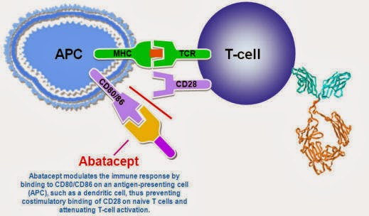
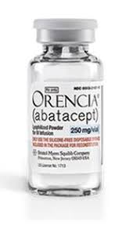
Abatacept for Steroid-Refractory
Chronic GVHD: Results From a Phase II
Clinical Trial
Notes:
GVHD, graft-vs-host disease.

Slide 28
Abatacept for Steroid-Refractory Chronic GVHD:
Results From a Phase II Clinical Trial
Abatacept: selective costimulation modulator that binds to CD80 and CD86 on antigen-presenting cells, thus diminishing CD28-mediated T-cell activation³
  In preclinical models, CD28 blockade has been shown to prevent GVHD via control of T-cell activation⁴
  On December 15, 2021, abatacept with a calcineurin inhibitor/MTX was approved by the FDA for prophylaxis of acute GVHD in adult and pediatric patients ≤2 years of age undergoing HSCT from an unrelated donor⁵
In phase I, abatacept achieved clinical PR in 44% of patients with steroid-refractory chronic GVHD, reduced prednisone usage in 51.3% of clinical responders, and was well tolerated with no DLTs⁶
Current study evaluated ORR with abatacept in patients with steroid-refractory chronic GVHD⁷
1. Arora. Biol Blood Marrow Transplant. 2016;22:449. 2. Malard. Leukemia. 2020;34:1229. 3. Herrero-Beaumont. Reumatol Clin.8:78. 4. Watkins. J Clin Invest. 2018;128:3991. 5. Abatacept PI. 6. Nahas. Blood. 2018;131:2836. 7. Koshy. ASH 2021. Abstr 264.
Notes:
DLT, dose-limiting toxicity; GVHD, graft-vs-host disease; HSCT, hematopoietic stem cell transplantation; methotrexate, MTX; ORR, overall response rate; PR, partial response.

Slide 29
Abatacept for Steroid-Refractory Chronic GVHD:
Study Design
Phase II study
Patients who underwent BM
or stem cell transplant with
myeloablative or RIC and
developed steroid-refractory
chronic GVHD*; ≥100 days
post transplant or lymphocyte
infusion; no starting/stopping other immunosuppressive agents ≤4 wk of study tx; on stable immunosuppressive regimen for 2 wk before enrollment
(N = 39)
Patients achieving CR or PR received treatment extension with abatacept
10 mg/kg Q4W for up to 12 additional doses
Abatacept
10 mg/kg Q2W
x 3 doses
1 mo
Abatacept
10 mg/kg Q4W
x 3 dose
*Defined as persistent signs and symptoms of chronic GVHD despite prednisone ≥0.25 mg/kg/day for ≥4 wk.
Primary endpoint: ORR
Koshy. ASH 2021. Abstr 264.
Notes:
BM, bone marrow; CR, complete response; GVHD, graft-vs-host disease; ORR, overall response rate; PR, partial response; RIC, reduced-intensity chemotherapy; tx, treatment.

Slide 30
Abatacept for Steroid-Refractory Chronic GVHD: Baseliane Characteristics
Characteristic | Patients (N = 39)
Median time from HCT to study entry, mo (range) | 43 (6-173)
Median prior treatments for chronic GVHD (range) | 5 (1-11)
Median age, yr (range) | 62 (25-77)
Female, n (%) | 21 (53.8)
ECOG PS, n (%) 0 1 2 | 1 (2.6) 27 (69.2) 11 (28.2)
Primary disease, n (%) ALL AML CML MDS MPD NHL MPN with fibrosis Myelofibrosis | 5 (12.8) 18 (46.2) 2 (5.1) 8 (20.5) 2 (5.1) 1 (2.6) 2 (5.1) 1 (2.6)
Transplant Characteristic, n (%) | Patients (N = 39)
Cell source BM PBSC | 4 (10.3) 35 (89.7)
Conditioning intensity Myeloablative Nonmyeloablative | 24 (61.5) 14 (35.9)
HLA match (A, B, C, DRB1) Matched related Matched unrelated Mismatched related Mismatched unrelated | 15 (38.4) 22 (56.4) 1 (2.6) 1 (2.6)
17 and 22 patients had moderate and severe chronic GVHD at baseline, respectively
Involvement of skin (85%), mouth (44%), eyes (69%), GI tract (18%), liver (23%), lungs (54%), joints (82%), genital tract (8%)
Koshy. ASH 2021. Abstr 264.
Notes:
ALL, acute lymphocytic leukemia; AML, acute myeloid leukemia; BM, bone marrow; CML, chronic myeloid leukemia; ECOG, Eastern Cooperative Oncology Group; GVHD, graft-vs-host disease; HCT, hematopoietic stem cell transplant; HLA, human leukocyte antigens; MDS, myelodysplastic syndromes; MPD, myeloproliferative disorders; MPN, myeloproliferative neoplasms; NHL, non-Hodgkin lymphoma; PBSC, peripheral blood stem cell; PS, performance status.

Slide 31
Abatacept for Steroid-Refractory Chronic GVHD:
Clinical Response
ORR: 49% (primary endpoint)
  CR: 0%
  PR: 49%
Disease progression: 26%
Significant and sustained reduction in prednisone dose beginning at Mo 1 of abatacept therapy
Outcome by Organ Site, % | Patients (N = 39)
CR or PR Skin Mouth Eyes GI tract Liver Lung Joints Genital tract | 15.4 21 23 10 15.4 33 21 3
Disease progression Skin Mouth Eyes Lung Joints | 8 10 5 3 5
Koshy. ASH 2021. Abstr 264.
Notes:
CR, complete response; GVHD, graft-vs-host disease; ORR, overall response rate; PR, partial response.

Slide 32
Abatacept for Steroid-Refractory Chronic GVHD:
Safety
AE, n | Patients (N = 39)
Neutropenia* Grade 2 Grade 3 Grade 4 | 5 2 2
Fatigue Grade 1 Grade 2 | 1 4
Headache Grade 2 | 4
Upper respiratory infection Grade 2 Grade 3 | 3 1
Serious AEs Possibly Related to Abatacept, n | Patients (N = 39)
Lung infection Grade 3 Grade 4 | 2 1
Hemolysis Grade 4 | 1†
Respiratory failure Grade 4 | 1†
Hepatic failure Grade 4 | 1†
Death (simultaneous HSV hepatitis) | 1†
†Events in same patient.
*9 events occurred in 4 patients.
Koshy. ASH 2021. Abstr 264.
Notes:
AE, adverse event; GVHD, graft-vs-host disease; HSV, herpes simplex virus.

Slide 33
Abatacept for Steroid-Refractory Chronic GVHD: Conclusions
In this phase II study, abatacept achieved an ORR of 49% in patients with steroid-refractory chronic GVHD
  Sustained reduction in prednisone dosing observed over time
Severe infections were not common, and infusions were well tolerated
Ongoing correlative immune studies aim to define the mechanism of action
Koshy. ASH 2021. Abstr 264.
Notes:
GVHD, graft-vs-host disease; ORR, overall response rate.

Slide 34
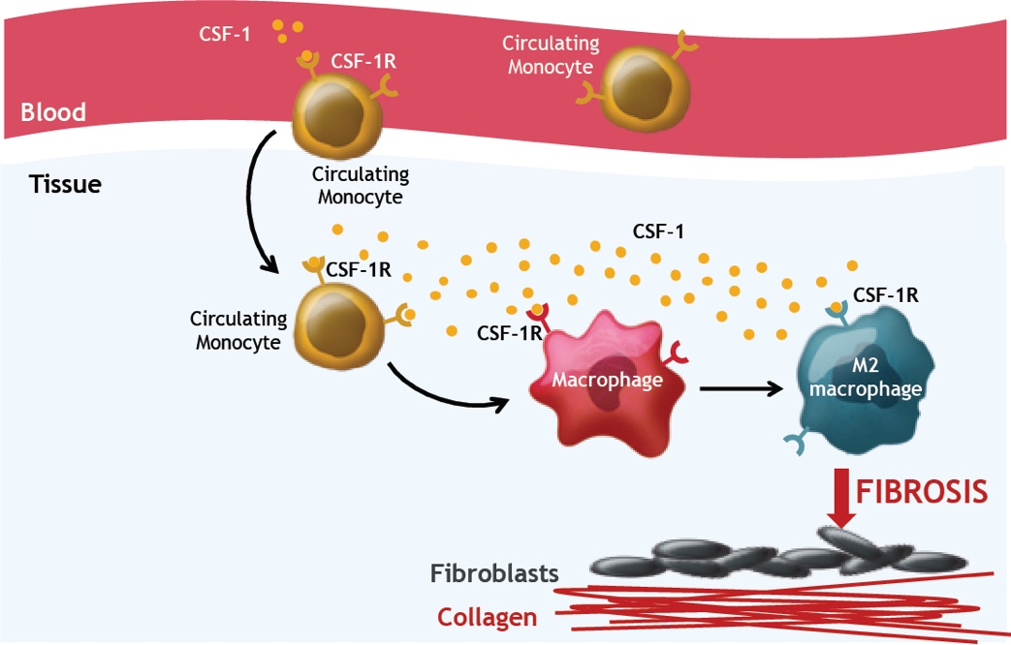
Phase I/II Study of Anti‒CSF-1R :Axatilimab

Slide 35
Axatilimab in Heavily Pretreated Chronic GVHD: Background; Phase I/II Study of Anti‒CSF-1R
Axatilimab is a high-affinity anti‒CSF-1R humanized IgG4 antibody administered via 30-min infusion every 2-4 wk to target circulating profibrotic monocytes^{1,2}
  CSF-1R signaling drives macrophage role in GVHD pathology
Phase I/II dose escalation/expansion study assessed safety, tolerability, and efficacy of axatilimab for chronic GVHD after ≥2 systemic therapies^{3,4}
  Phase I suggested safe clinical activity in chronic GVHD;
  phase II analysis presented here
1. Saidu. Front Immunol. 2020;11:578314. 2. NCT03604692. 3. Arora. ASH 2020. Abstr 358. 4. Lee. ASH 2021. Abstr 263.
Notes:
Allo-HSCT, allogenic hematopoietic stem cell transplant; GVHD, graft-vs-host disease; IgG4, immunoglobulin G4.

Slide 36
Axatilimab in Chronic GVHD: Study Design
Phase I/II dose escalation/expansion study
Phase I endpoints: safety, ORR, RP2D (analysis identified as 1.0 mg/kg Q2W)
Phase II primary endpoint: ORR (by 2014 NIH chronic GVHD criteria)
Phase I Escalation
(n = 17)
Phase II Expansion
(n = 23)
3.0 mg/kg Q2W
(n = 6)
Patients aged ≥6 yr
with active chronic GVHD after ≥2 prior treatments; KPS ≥60
(N = 40)
3.0 mg/kg Q4W
(n = 6)
1.0 mg/kg Q2W
(n = 23)
1.0 mg/kg Q2W
(n = 3)
0.5 mg/kg Q2W
(n = 1)
0.15 mg/kg Q2W
(n = 1)
Lee. ASH 2021. Abstr 263.
Notes:
GVHD, graft-vs-host disease; KPS, Karnofsky performance status; NIH, National Institutes of Health; ORR, overall response rate; RP2D, recommended phase II dose.

Slide 37
Axatilimab in Chronic GVHD: Infection Rates
Infection, n (%) | 1 mg/kg Q2W (n = 26) | 3 mg/kg Q4W (n = 6) | All Patients (N = 40)
All infections | 12 (46) | 4 (67) | 19 (48)
Upper respiratory infection | 7 (27) | 2 (33) | 9 (18)
Cellulitis | 2 (8) | 2 (33) | 4 (10)
Pneumonia | 2 (8) |  | 2 (5)
Pseudomonas infection | 1 (4) | 1 (17) | 2 (5)
Urinary tract infection | 1 (4) | 1 (17) | 2 (5)
Influenza | 1 (4) |  | 2 (5)
COVID-19 |  | 1 (17) | 1 (3)
Eye infection |  | 1 (17) | 1 (3)
Klebsiella infection | 1 (4) |  | 1 (3)
Esophageal candidiasis | 1 (4) |  | 1 (3)
Septic arthritis | 1 (4) |  | 1 (3)
There were no reported CMV or EBV reactivations
Lee. ASH 2021. Abstr 263.
Notes:
CMV, cytomegalovirus; EBV, Epstein-Barr virus; GVHD, graft-vs-host disease.

Slide 38
Axatilimab in Chronic GVHD: Lee Symptom Scale
10
LSS scores improved in
most patients
  Median change: -7.8 points (range: 3.1 to -37.6)
  16 (53%) of 30
  LSS-evaluable patients achieved 7-point reduction from baseline
Improvement seen irrespective of response by consensus NIH criteria
0
-10
Best Change From Baseline
-20
-30
3 mg/kg Q4W phase I
1 mg/kg Q2W phase I
1 mg/kg Q2W phase II
Responder
-40
Lee. ASH 2021. Abstr 263. Reproduced with permission.
Notes:
GVHD, graft-vs-host disease; LSS, Lee Symptom Scale; NIH, National Institutes of Health.

Slide 39
Axatilimab in Chronic GVHD: Investigators’ Conclusions
In patients with chronic GVHD who received ≥2 systemic therapies, axatilimab resulted in ORR of 68% at the doses selected for further development¹
53% of patients showed clinically meaningful improvement in symptoms
by LSS¹
Axatilimab appears to be well tolerated in this population with no observed viral reactivations¹
Global, open-label, pivotal phase II trial (AGAVE-201) is evaluating axatilimab at 0.3 mg/kg, 1 mg/kg, and 3 mg/kg Q2W in patients aged ≥2 yr with recurrent or refractory active chronic GVHD who received ≥2 prior
systemic therapies²
1. Lee. ASH 2021. Abstr 263. 2. NCT04710576.
Notes:
GVHD, graft-vs-host disease; LSS, Lee Symptom Scale; ORR, overall response rate.

Slide 40
iNTEGRATE: Ibrutinib Plus Corticosteroids in Patients With New Onset Chronic GVHD
Multinational, randomized, placebo-controlled, double-blind phase III trial
Primary endpoint: chronic GVHD response rate at 48 wks
Secondary endpoints: safety, OS, steroid dose reduction, time to withdrawal of immunosuppressants
48 wks
Eligibility: patients
≥ 12 yrs with frontline moderate and severe chronic GVHD; using NIH 2014 chronic GVHD criteria
(N = 193)
Ibrutinib + prednisone
Primary evaluated
at 48 wks
Secondary outcomes evaluated at 24 wks through 3 yrs
Placebo + prednisone
NCT02959944.
Notes:
GVHD, graft-vs-host disease.

Slide 45
Chronic GVHD With HCT: Conclusions
cGVHD is clinically heterogeneous and pathogenesis complex involving dysregulated B-cells and T-cells due to alloreactive damage to thymus, BM, and germinal centers; cGVHD pathogenesis involves macrophage mediated fibrosis
FDA approved for cGVHD treatment after ≥1 line of therapy:
  Ibrutinib 420 mg/day
    Irreversibly inhibits activated B-cells and TFH cells inhibiting GC and allo-antibodies
    PCYC1129: Ibrutinib 67% ORR at 1 yr and 31% CR at 2-yr follow-up
  Ruxolitinib 10 mg twice daily
    Inhibits STAT3 decreasing Th17 cells; decreased IL17 and TGF-ß decreases macrophage fibrosis
    REACH3: ruxolitinib with higher ORR at Wk 24 than BAT (49.7% vs 25.6%; P <.0001)
FDA approved for cGVHD treatment after ≥2 lines of therapy:
  Belumosudil 200 mg/day
    Inhibits Th17 cells, IL-21 secretion, regulates profibrotic genes and mediates stress fiber formation.
    Phase II ROCKstar: belumosudil ORR: 74% with daily dosing (200 mg BID ORR: 77%)
Sahaf. Biol Blood Marrow Transplant. 2018;24:S20. Gomez-Rodriguez. FEBS J. 2011;278:1980. Miklos. Blood. 2017;130:2243. Ibrutinib PI. Chao. NEJM. 2020;382:1853. Zeiser. NEJM. 2021;385:228. Ruxolitinib PI. Cutler. Blood. 2021;38:2278. Belumosudil PI.
Notes:
BAT, best available therapy; BM, bone marrow; CR, complete response; GVHD, graft-vs-host disease; IL, interleukin; ORR, overall response rate; TFH, T follicular helper.

Slide 46
How Are Physicians Choosing cGVHD Therapies?
Clinical efficacy
  NIH response, durability, composite endpoints
  Organs involved
  Retrospective analysis vs prospective rigor
  Single institution vs multicenter trials
Toxicity profile
Mechanism of action
Mode of delivery
  Hickman access, IV infusion, injection, pill
Patient compliance
Cost
Notes:
cGVHD, chronic graft-vs-host disease; NIH, National Institutes of Health.

Slide 47
Shared Decision-Making: SHARE Approach
5-step process for shared decision-making
Includes exploring and comparing benefits and risks of each management option through meaningful dialogue about what matters most to the patient:
  Seek patient’s participation
  Help patient explore and compare treatment options
  Assess patient’s values and preferences
  Reach a decision with patient
  Evaluate patient’s decision
https://www.ahrq.gov/health-literacy/professional-training/shared-decision/index.html. Accessed November 21, 2020.
Kane. CA Cancer J Clin. 2014;64:377.

Slide 48
THANK YOU
FOR YOUR ATTENTION

